Slide 1

Go, Change the World

Slide 2
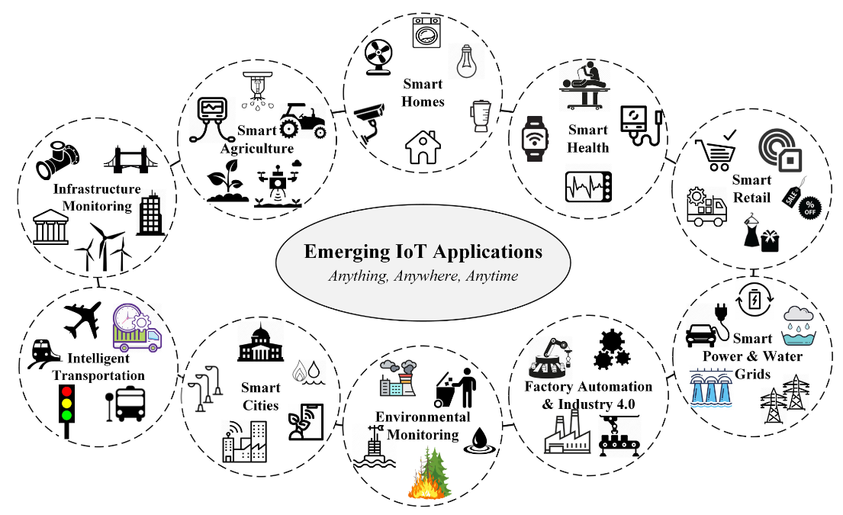
Definition
Cyber-Physical Systems (CPS) are integrations of computation, networking, and physical processes
CPS Applications

Slide 3
List of Laboratory Experiments
Ex. No. | Experiments
PART A
1 | Write a program with ESP8266 to calculate the distance of an obstacle. If the distance calculated is less than a certain value turns on a buzzer /beeper and display the distance in LCD /OLED.
2 | Write a program with ESP8266 to capture the temperature and relative humidity from the environment and display the same using LCD/ LED.
3 | Write a program to collect data using Temperature sensors on RaspberryPi and apply visualization techniques to display the processed data
4 | Write a program to collect data using RaspberryPi from the environment, and upload data to the any of the Cloud Platform.
5 | Write an interactive python script on RaspberryPi to control servo motor.
6 | Write a program to capture the live image using the USB Camera on Jetson Nano and send it as Notification.
7 | Write a program to capture the live image using the USB Camera on Jetson Nano development kit and mark the region of interest and display using Open CV.
8 | Write a program to show the communication between client and server using RaspberryPi3.
PART B
A batch of two students should develop a prototype for any one of the Sustainable Development Goals. The prototype should demonstrate the use of various sensors & actuators, and embedded modules in real-time applications.

Slide 4
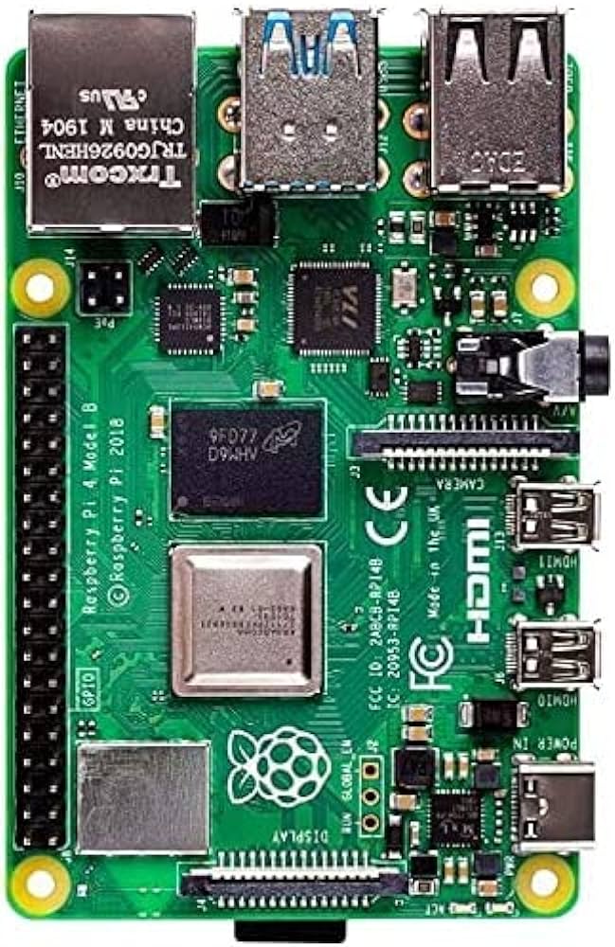
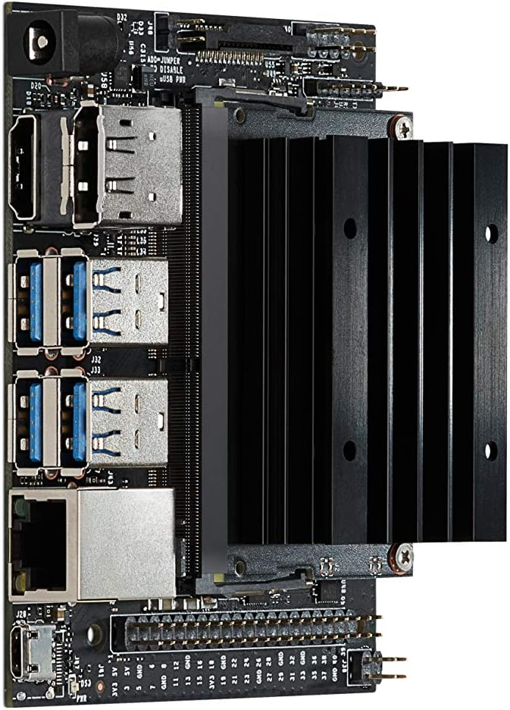
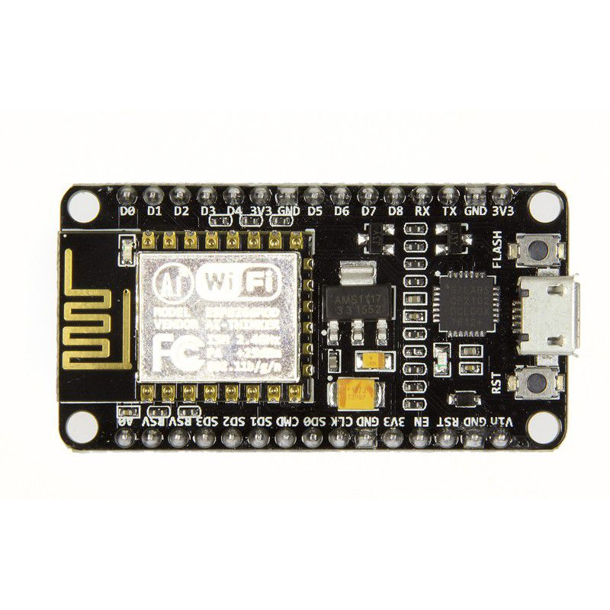
Embedded Device Used in the Lab
Node MCU (ESP8266)
RaspberryPi 4
Jetson Nano

Slide 5
Embedded Device Used in the Lab (Contd.)
Node MCU (ESP8266)
The NodeMCU (Node Micro Controller Unit) is an open-source software and hardware development environment built around an inexpensive System-on-a-Chip (SoC) called the ESP8266.
The ESP8266, designed and manufactured by Espressif Systems, contains the crucial elements of a computer: CPU, RAM, networking (WiFi), and even a modern operating system and SDK.
The ESP8266 can run Arduino and MicroPython, which are two popular software platforms for programming the board.
It has 11 digital input/output pins, 6 analog input pins, and 1 UART header, making it a versatile and powerful platform for electronic projects.
That makes it an excellent choice for Internet of Things (IoT) projects of all kinds.

Slide 6
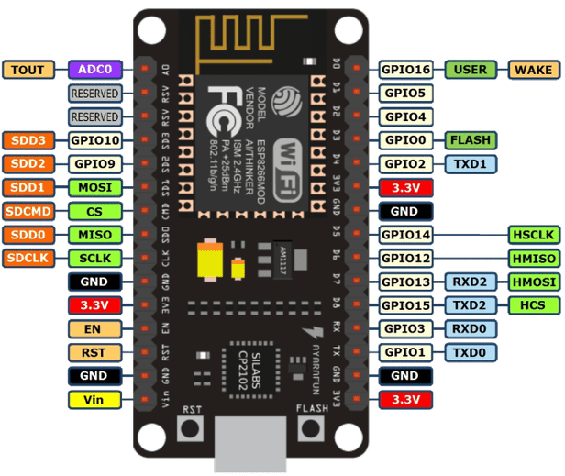
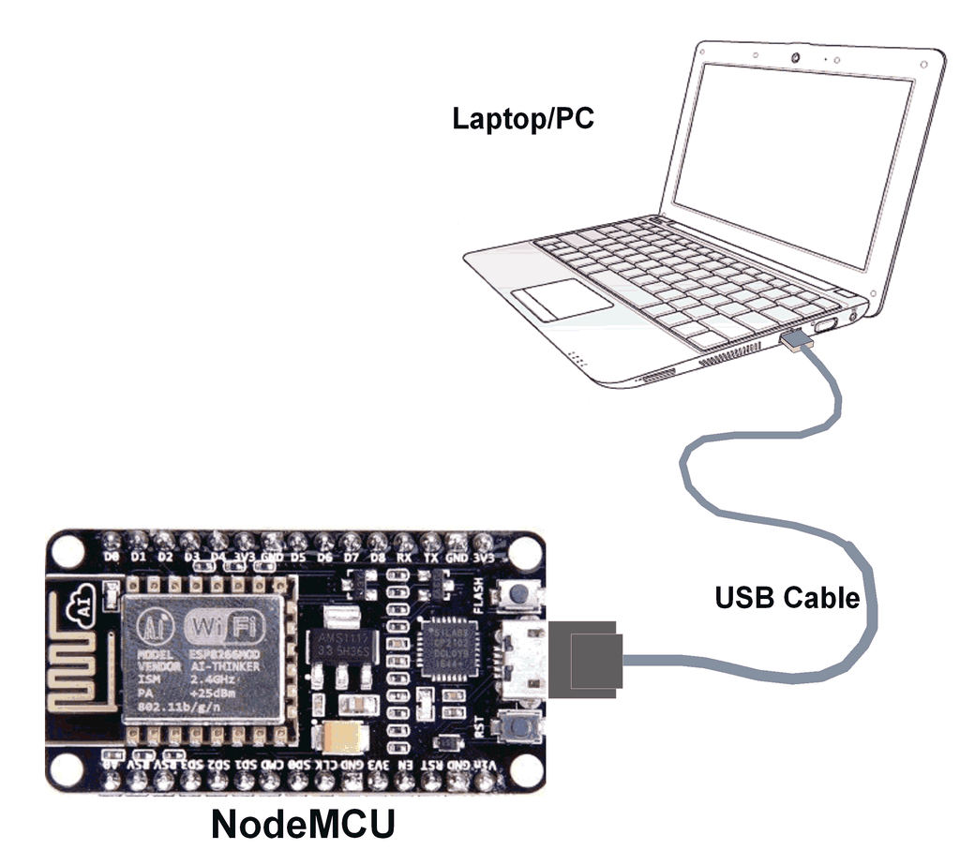
Embedded Device Used in the Lab (Contd.)
Node MCU (ESP8266)

Slide 7
Embedded Device Used in the Lab (Contd.)
RaspberryPi 4
Raspberry Pi 4 is the latest version of the popular single-board computer (SBC) created by the Raspberry Pi Foundation.
It was released in April 2019 and has upgraded features compared to its predecessors.
This device is designed for hackers, makers, and beginners to create and innovate with its versatility.
The Raspberry Pi 4 has 4GB RAM, 1.5GB Ethernet, Bluetooth 5.0, two USB 3.0 ports, a 3.5mm headphone jack, micro-HDMI, Ethernet, and micro-SD card slots.
It also has an optional Wi-Fi and Bluetooth module.
The Raspberry Pi supports various operating systems, including Raspbian (officially supported by the Raspberry Pi Foundation), Ubuntu, and other Linux distributions.

Slide 8
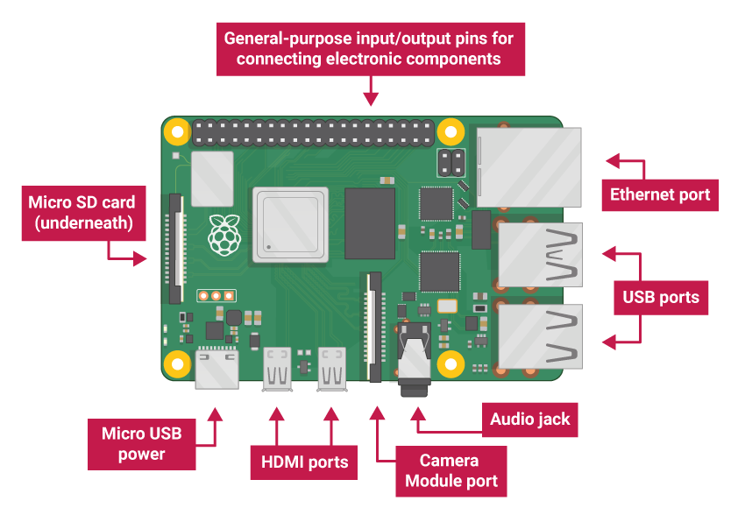
Embedded Device Used in the Lab (Contd.)
RaspberryPi 4

Slide 9
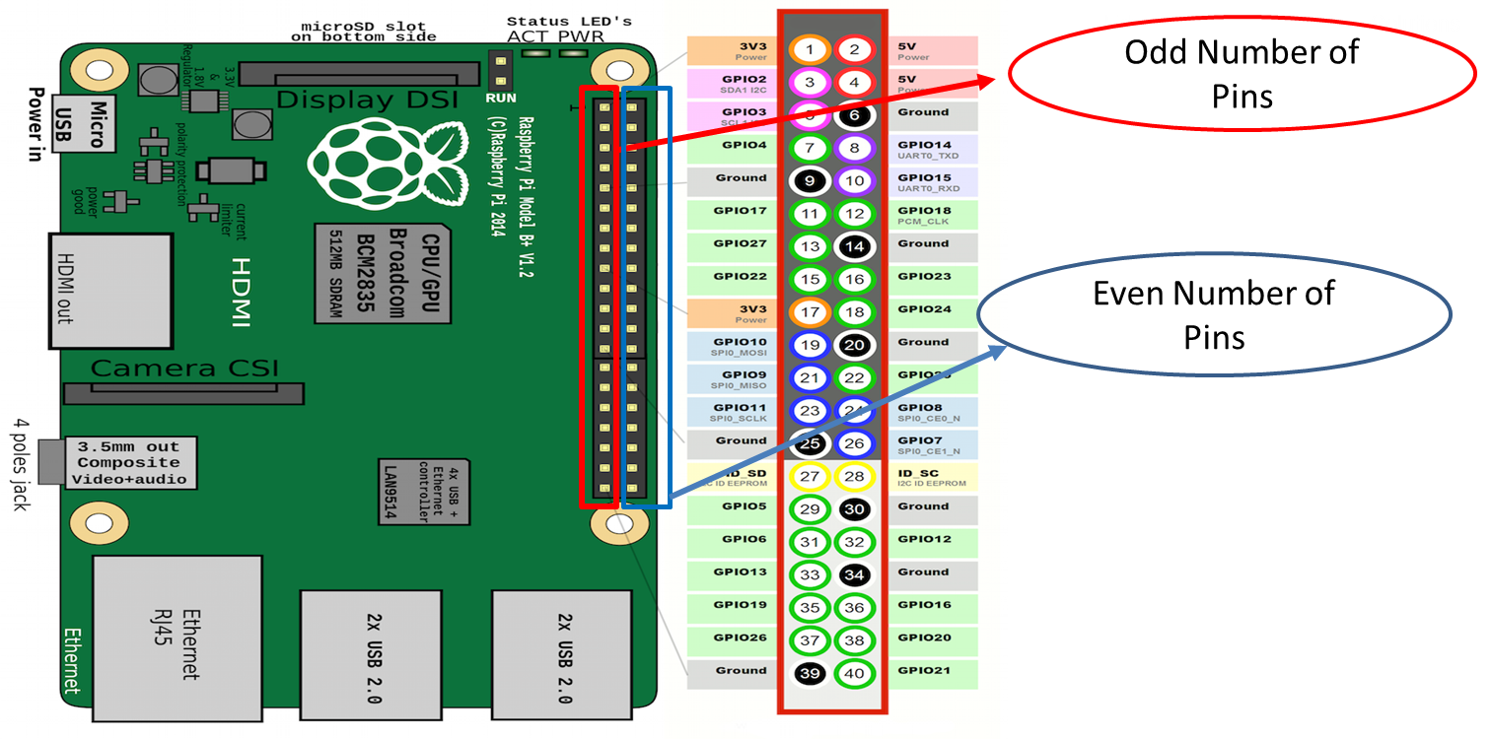
Embedded Device Used in the Lab (Contd.)
RaspberryPi 4
Input Modes
BCM Mode
GPIO.setmode(GPIO.BCM)
2. Board Numbering
GPIO.setmode(GPIO.BOARD)

Slide 10
Embedded Device Used in the Lab (Contd.)
Jetson Nano
The Jetson Nano is a compact and powerful development board that can be used to create AI and edge computing applications.
It has a built-in Wi-Fi module, 4GB of RAM, and up to 1TB of storage, making it ideal for IoT and automation projects (ARM Cortex-A53 processor).
To connect the Jetson Nano to other devices, you can use a variety of connectivity options including USB-C, HDMI, Ethernet.
Additionally, you can remotely access and manage the Jetson Nano using the Jetson Connect app, which is available for both Android and iOS devices.

Slide 11
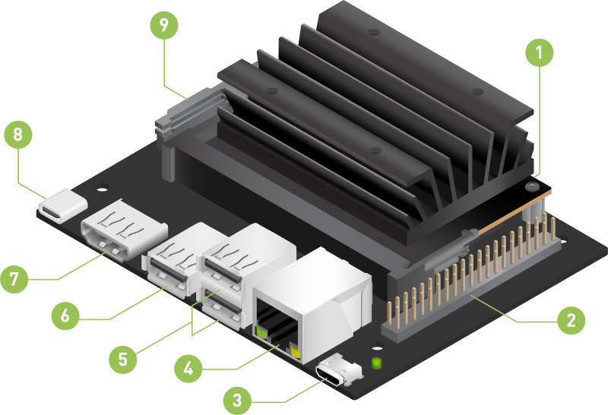
Embedded Device Used in the Lab (Contd.)
Jetson Nano
MIPI CSI-2 Camera Connector
Micro SD Card Slot
USB-C for 5V Power Input
HDMI Port
USB 3.0 Ports
GPIO Headers
USB 2.0 Ports
Gigabit Ethernet port
Micro-USB port

Slide 12
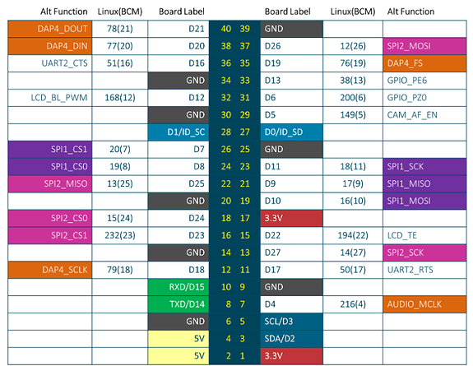
Embedded Device Used in the Lab (Contd.)
Jetson Nano

Slide 13
Embedded Device Used in the Lab (Contd.)
Jetson Nano

Slide 14
Experiment 1: ESP8266: distance with buzzer + display on OLED (HC-SR04)
Library includes
#include <Arduino.h>
#include <Adafruit_GFX.h>
#include <Adafruit_SSD1306.h>
OLED object setup
#define SCREEN_WIDTH 128
#define SCREEN_HEIGHT 64
Adafruit_SSD1306 display(SCREEN_WIDTH, SCREEN_HEIGHT, &Wire, -1);

Slide 15
Experiment 1: ESP8266: distance with buzzer + display on OLED (HC-SR04)
Pin assignments & constants
const int trigPin = D5;
const int echoPin = D6;
const int buzzer = D2;
const float SPEED_OF_SOUND = 0.0343f;
const int THRESHOLD_CM = 20;
Ultrasonic read helper
long readUS() {
digitalWrite(trigPin, LOW); delayMicroseconds(2);
digitalWrite(trigPin, HIGH); delayMicroseconds(10);
digitalWrite(trigPin, LOW);
return pulseIn(echoPin, HIGH, 30000); // timeout 30ms}

Slide 16
Experiment 1: ESP8266: distance with buzzer + display on OLED (HC-SR04)
setup() — one-time initialization
void setup() {
pinMode(trigPin, OUTPUT); pinMode(echoPin, INPUT);
pinMode(buzzer, OUTPUT); digitalWrite(buzzer, LOW);
Serial.begin(115200); if(!display.begin(SSD1306_SWITCHCAPVCC, 0x3C)) { for(;;); }
display.clearDisplay(); display.display();}
loop() — runs repeatedly
void loop() {
long duration = readUS();
float distance_cm = (duration * SPEED_OF_SOUND) / 2.0; // round trip
bool alert = (distance_cm > 0 && distance_cm < THRESHOLD_CM);

Slide 17
Experiment 1: ESP8266: distance with buzzer + display on OLED (HC-SR04)
Buzzer control
digitalWrite(buzzer, alert ? HIGH : LOW); //Turn the active buzzer ON for an alert; otherwise keep it OFF.
OLED UI
display.clearDisplay();
display.setTextSize(2); display.setTextColor(SSD1306_WHITE);
display.setCursor(0, 0); display.print("Dist:");
display.setCursor(0, 28);
if (duration == 0) display.print("No echo");
else { display.print(distance_cm, 1); display.print(" cm"); }

Slide 18
Experiment 1: ESP8266: distance with buzzer + display on OLED (HC-SR04)
display.setCursor(0, 52);
if (alert) display.print("ALERT!");
display.display();
Serial debug + pacing
Serial.printf("Distance: %.1f cm\n", distance_cm);
delay(200);}

Slide 19
Experiment 2: ESP8266: temperature & humidity (DHT) to LCD/LED)
#include <Arduino.h>
#include <Wire.h>
#include <Adafruit_GFX.h>
#include <Adafruit_SSD1306.h>
#include <DHT.h>
// ---------- DHT setup ----------
#define DHTPIN 4 // GPIO pin connected to DHT
#define DHTTYPE DHT11 // Change to DHT22 or DHT21 if you use those
DHT dht(DHTPIN, DHTTYPE);

Slide 20
Experiment 2: ESP8266: temperature & humidity (DHT) to LCD/LED)
// ---------- OLED setup ----------
#define SCREEN_WIDTH 128
#define SCREEN_HEIGHT 64
#define OLED_RESET -1 // Reset pin (or -1 if sharing Arduino reset)
#define OLED_ADDR 0x3C // Most 128x64 modules use 0x3C
Adafruit_SSD1306 display(SCREEN_WIDTH, SCREEN_HEIGHT, &Wire, OLED_RESET);
// ---------- LED (optional) ----------
const int ledPin = LED_BUILTIN; // On some boards (e.g., ESP8266), LED is active LOW
void setup() {
pinMode(ledPin, OUTPUT);
digitalWrite(ledPin, HIGH); // Keep LED off initially (ESP8266 is active LOW)
Wire.begin();

Slide 21
Experiment 2: ESP8266: temperature & humidity (DHT) to LCD/LED)
// Initialize OLED
if (!display.begin(SSD1306_SWITCHCAPVCC, OLED_ADDR)) {
// If display init fails, blink LED rapidly
while (true) {
digitalWrite(ledPin, LOW); delay(100);
digitalWrite(ledPin, HIGH); delay(100);
}
}
display.clearDisplay();
display.setTextColor(SSD1306_WHITE);
display.cp437(true); // Enable extended ASCII (for degree symbol)

Slide 22
Experiment 2: ESP8266: temperature & humidity (DHT) to LCD/LED)
// Splash
display.setTextSize(1);
display.setCursor(0, 0);
display.println("Env Monitor");
display.println("Initializing...");
display.display();
// Initialize DHT
dht.begin();
delay(1000);
}

Slide 23
Experiment 2: ESP8266: temperature & humidity (DHT) to LCD/LED)
void loop() {
// Read sensor (DHT11 prefers ~1–2s between reads)
float h = dht.readHumidity();
float t = dht.readTemperature(); // Celsius
if (isnan(h) || isnan(t)) {
// Sensor read failed
display.clearDisplay();
display.setTextSize(1);
display.setCursor(0, 0);
display.println("DHT read failed");
display.println("Check wiring/sensor");
display.display();

Slide 24
Experiment 2: ESP8266: temperature & humidity (DHT) to LCD/LED)
// Blink LED to signal error
digitalWrite(ledPin, LOW); delay(250);
digitalWrite(ledPin, HIGH); delay(250);
return; // Try again on next loop
}
// Display readings
display.clearDisplay();
display.setTextSize(2);
display.setCursor(0, 0);
display.print("T: ");
display.print(t, 1);
display.write((uint8_t)248); // Degree symbol
display.print("C");

Slide 25
Experiment 2: ESP8266: temperature & humidity (DHT) to LCD/LED)
display.setCursor(0, 32);
display.print("H: ");
display.print(h, 1);
display.print("%");
display.display();
// Optional: quick LED blink to show updates
digitalWrite(ledPin, LOW); delay(50);
digitalWrite(ledPin, HIGH);
// DHT11: wait ~2s between reads; DHT22 can be faster (~2s safe for both)
delay(2000);
}

Slide 26
Experiment 3: Raspberry Pi 3: collect temperature data & visualize
Sensor choices: DHT22 (GPIO4). Install (Pi OS):
sudo apt-get update
sudo apt-get install -y python3-pip python3-opencv
pip3 install Adafruit_DHT matplotlib pandas
import time, csv, os
import Adafruit_DHT as dht
import pandas as pd
import matplotlib.pyplot as plt

Slide 27
Experiment 3: Raspberry Pi 3: collect temperature data & visualize
Sensor Configuration
SENSOR = dht.DHT22
PIN = 4
CSV = "env_log.csv“
Create CSV Header if Not Exists
if not os.path.exists(CSV):
with open(CSV, "w", newline="") as f:
csv.writer(f).writerow(["timestamp","temp_c","humidity"])
Start Collecting Data
print("Collecting data... (Ctrl+C to stop)")
try:
while True:
h, t = dht.read_retry(SENSOR, PIN)

Slide 28
Experiment 3: Raspberry Pi 3: collect temperature data & visualize
Read and Log Sensor Data
if h is not None and t is not None:
with open(CSV, "a", newline="") as f:\
csv.writer(f).writerow([int(time.time()), round(t,2), round(h,2)])
print(f"T={t:.1f}C H={h:.1f}%")
time.sleep(10)
Graceful Exit
except KeyboardInterrupt:
Pass

Slide 29
Experiment 3: Raspberry Pi 3: collect temperature data & visualize
Visualization (after collection)
Now we use pandas + matplotlib to plot the saved data.
Load and Prepare Data
df = pd.read_csv(CSV)
df = df.tail(300)
df["time_min"] = (df["timestamp"] - df["timestamp"].iloc[0]) / 60
df_ma = df.rolling(window=5, min_periods=1).mean()
Temperature Plot
plt.figure()
plt.plot(df["time_min"], df["temp_c"], label="Temp (C)")
plt.plot(df["time_min"], df_ma["temp_c"], label="Temp (C) MA")
plt.xlabel("Minutes"); plt.ylabel("°C"); plt.legend(); plt.title("Temperature over time")
plt.show()

Slide 30
Experiment 3: Raspberry Pi 3: collect temperature data & visualize
Humidity Plot
plt.figure()
plt.plot(df["time_min"], df["humidity"], label="Humidity (%)")
plt.plot(df["time_min"], df_ma["humidity"], label="Humidity (%) MA")
plt.xlabel("Minutes"); plt.ylabel("%"); plt.legend(); plt.title("Humidity over time")
plt.show()

Slide 31
Experiment 4: Raspberry Pi 3/4: collect temperature data & visualize over thingspeak
Prepare ThingSpeak
Create a free account at ThingSpeak.
Create a New Channel with:
Field 1: Temperature (°C)
Field 2: Humidity (%)
Go to API Keys tab and copy the Write API Key (looks like ABC123...).
Raspberry Pi setup (one-time) - is already done by a few; however, it is not mandatory. Unless you’re more enthusiastic.. To learn
sudo apt update && sudo apt -y upgrade
sudo apt -y install python3-pip python3-venv python3-dev libgpiod2
mkdir -p ~/dht-thingspeak && cd ~/dht-thingspeak

Slide 32
Experiment 4: Raspberry Pi 3/4: collect temperature data & visualize over thingspeak
python3 -m venv .venv
source .venv/bin/activate
pip install --upgrade pip
pip install adafruit-circuitpython-dht requests
We use adafruit-circuitpython-dht (modern & maintained). On newer Raspberry Pi OS, it uses libgpiod instead of old RPi.GPIO timing hacks.

Slide 33
Experiment 4: Raspberry Pi 3/4: collect temperature data & visualize over thingspeak
The code (full script)
Create dht_to_thingspeak.py in ~/dht-thingspeak:
import os
import time
import sys
import socket
from datetime import datetime
import requests
import adafruit_dht
import board

Slide 34
Experiment 4: Raspberry Pi 3/4: collect temperature data & visualize over thingspeak
# Set your ThingSpeak WRITE API KEY here or via environment variable THINGSPEAK_WRITE_KEY
THINGSPEAK_WRITE_KEY = os.getenv("THINGSPEAK_WRITE_KEY", "PUT_YOUR_WRITE_API_KEY_HERE")
# Sensor model: "DHT22" (AM2302) or "DHT11"
SENSOR_MODEL = os.getenv("DHT_MODEL", "DHT11")
# GPIO pin: we use board.D4 (BCM GPIO4, physical pin 7)
GPIO_PIN = board.D4
# Read/upload interval seconds (>= 15 sec per ThingSpeak)
INTERVAL_SEC = int(os.getenv("READ_INTERVAL_SEC", "20"))
# Optional CSV logging
CSV_LOG = os.getenv("CSV_LOG", "readings.csv") # set to "" to disable

Slide 35
Experiment 4: Raspberry Pi 3/4: collect temperature data & visualize over thingspeak
if THINGSPEAK_WRITE_KEY == "PUT_YOUR_WRITE_API_KEY_HERE":
print("ERROR: Please set your ThingSpeak WRITE API KEY in the script or THINGSPEAK_WRITE_KEY env var.")
sys.exit(1)
# Create a DHT object for the chosen sensor model on the chosen pin.
if SENSOR_MODEL.upper() == "DHT11":
dht_device = adafruit_dht.DHT11(GPIO_PIN)
else:
dht_device = adafruit_dht.DHT22(GPIO_PIN)

Slide 36
Experiment 4: Raspberry Pi 3/4: collect temperature data & visualize over thingspeak
def upload_to_thingspeak(temp_c, humidity):
"""Send data to ThingSpeak via HTTP POST."""
url = "https://api.thingspeak.com/update"
payload = {
"api_key": THINGSPEAK_WRITE_KEY,
"field1": f"{temp_c:.2f}",
"field2": f"{humidity:.2f}",
}
r = requests.post(url, data=payload, timeout=10)
# ThingSpeak returns an entry ID (int) or 0 on failure
if r.status_code == 200 and r.text.strip().isdigit() and int(r.text.strip()) > 0:
return int(r.text.strip())
else:
raise RuntimeError(f"ThingSpeak update failed: HTTP {r.status_code}, body='{r.text.strip()}'")

Slide 37
Experiment 4: Raspberry Pi 3/4: collect temperature data & visualize over thingspeak
def write_csv(timestamp, temp_c, humidity):
"""Append a CSV line for local backup."""
if not CSV_LOG:
return
header_needed = not os.path.exists(CSV_LOG)
with open(CSV_LOG, "a", encoding="utf-8") as f:
if header_needed:
f.write("timestamp,temp_c,humidity\n")
f.write(f"{timestamp},{temp_c:.2f},{humidity:.2f}\n")

Slide 38
Experiment 4: Raspberry Pi 3/4: collect temperature data & visualize over thingspeak
def main():
hostname = socket.gethostname()
print(f"Starting DHT uploader on {hostname}. Sensor={SENSOR_MODEL} GPIO=GPIO4 Interval={INTERVAL_SEC}s")
# First read sometimes fails immediately after sensor init
time.sleep(2)
while True:
ts = datetime.now().isoformat(timespec="seconds")
try:
# Read may raise transient errors; that's normal for DHTs
temperature_c = dht_device.temperature
humidity = dht_device.humidity
if temperature_c is None or humidity is None:
raise RuntimeError("Sensor returned None")

Slide 39
Experiment 4: Raspberry Pi 3/4: collect temperature data & visualize over thingspeak
# Basic sanity clamp
if not ( -40.0 <= temperature_c <= 125.0 and 0.0 <= humidity <= 100.0 ):
raise ValueError(f"Out-of-range reading: T={temperature_c}, H={humidity}")
entry_id = upload_to_thingspeak(temperature_c, humidity)
write_csv(ts, temperature_c, humidity)
print(f"[{ts}] OK → ThingSpeak entry {entry_id} | Temp={temperature_c:.2f}°C Hum={humidity:.2f}%")
except (RuntimeError, ValueError, requests.RequestException) as e:
# DHT often throws intermittent errors; just log and continue
print(f"[{ts}] WARN: {e}")
# Respect rate limit
time.sleep(INTERVAL_SEC)

Slide 40
Experiment 4: Raspberry Pi 3/4: collect temperature data & visualize over thingspeak
if __name__ == "__main__":
try:
main()
except KeyboardInterrupt:
print("\nExiting...")
finally:
try:
dht_device.exit()
except Exception:
pass
Make it executable: chmod +x ~/dht-thingspeak/dht_to_thingspeak.py

Slide 41
Experiment 4: Raspberry Pi 3/4: collect temperature data & visualize over thingspeak
How many files?
On the Raspberry Pi: just one Python file that (1) reads the DHT sensor and (2) uploads to ThingSpeak.
On the cloud (ThingSpeak): you don’t upload files. You only configure a Channel (fields for Temp & Humidity) and ThingSpeak automatically draws the default graphs.

Slide 42
Experiment 5: Raspberry Pi 3/4: Servo Motor
Hardware assumptions
Board: Raspberry Pi 4
Servo: standard 3-wire (GND, VCC, signal)
Connections (example):
Servo GND → Raspberry Pi GND
Servo VCC (5V or 3.3V, as per servo spec!) → Pi 5V pin
Servo Signal → Raspberry Pi GPIO 17 (pin 11, BCM numbering)
pip install RPi.GPIO
Code: servo_control.py
#!/usr/bin/env python3
import RPi.GPIO as GPIO
import time
# === Configuration ===
SERVO_PIN = 17 # BCM pin number where the servo signal is connected
PWM_FREQUENCY = 50 # 50 Hz for typical hobby servos

Slide 43
Experiment 5: Raspberry Pi 3/4: Servo Motor
def angle_to_duty_cycle(angle: float) -> float:
"""
Convert angle (0–180) to duty cycle.
Typical servo: ~2.5% (0°) to ~12.5% (180°).
You may need to tweak these numbers depending on your servo.
"""
min_dc = 2.5 # duty cycle for 0°
max_dc = 12.5 # duty cycle for 180°
return min_dc + (max_dc - min_dc) * (angle / 180.0)
def setup():
GPIO.setmode(GPIO.BCM)
GPIO.setup(SERVO_PIN, GPIO.OUT)
pwm = GPIO.PWM(SERVO_PIN, PWM_FREQUENCY)
pwm.start(0) # start with 0% duty cycle
return pwm

Slide 44
Experiment 5: Raspberry Pi 3/4: Servo Motor
def main():
pwm = setup()
print("=== Servo Control (Raspberry Pi) ===")
print("Enter angle between 0 and 180 degrees.")
print("Type 'q' or 'quit' to exit.\n")
try:
while True:
user_input = input("Enter angle (0-180): ").strip().lower()
if user_input in ("q", "quit", "exit"):
print("Exiting...")
break

Slide 45
Experiment 5: Raspberry Pi 3/4: Servo Motor
# Validate numeric input
try:
angle = float(user_input)
except ValueError:
print("Please enter a valid number or 'q' to quit.")
continue
if not 0 <= angle <= 180:
print("Angle must be between 0 and 180.")
continue
duty = angle_to_duty_cycle(angle)
print(f"Moving servo to {angle:.1f}° (duty cycle ≈ {duty:.2f}%)")

Slide 46
Experiment 5: Raspberry Pi 3/4: Servo Motor
pwm.ChangeDutyCycle(duty)
time.sleep(0.5) # allow servo to reach the position
# Optional: stop sending pulses (some servos jitter less this way)
pwm.ChangeDutyCycle(0)
except KeyboardInterrupt:
print("\nInterrupted by user (Ctrl+C).")
finally:
pwm.stop()
GPIO.cleanup()
print("GPIO cleaned up. Goodbye!")
if __name__ == "__main__":
main()
How to run:
chmod +x servo_control.py
sudo ./servo_control.py
Then type angles like 0, 90, 180, etc.

Slide 47
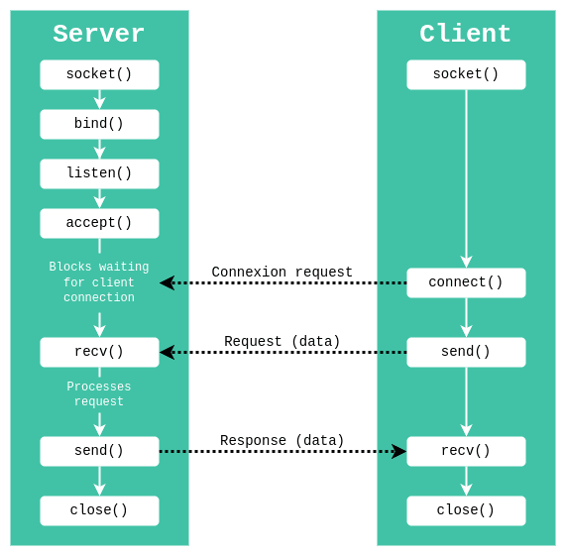
Experiment 8: Socket Programming

Slide 48
Experiment 8: Client – Server Paradigm
We’ll create two programs:
server.py – listens for client connections, receives messages, sends reply
client.py – connects to server, sends messages typed by user
Server program: server.py
#!/usr/bin/env python3
import socket
HOST = "127.0.0.1" # localhost (use Pi's IP if connecting from another machine)
PORT = 5000 # any free port >1024
def main():
# Create TCP socket
server_socket = socket.socket(socket.AF_INET, socket.SOCK_STREAM)
# Allow quick reuse of the port after program exit
server_socket.setsockopt(socket.SOL_SOCKET, socket.SO_REUSEADDR, 1)

Slide 49
Experiment 8: Client – Server Paradigm
# Bind socket to address and port
server_socket.bind((HOST, PORT))
server_socket.listen(1) # listen for 1 connection (can increase if needed)
print(f"Server listening on {HOST}:{PORT}...")
# Accept a client connection
conn, addr = server_socket.accept()
print(f"Connected by {addr}")
with conn:
while True:
data = conn.recv(1024) # receive up to 1024 bytes
if not data:
print("Client disconnected.")
break

Slide 50
Experiment 8: Client – Server Paradigm
message = data.decode("utf-8")
print(f"Client says: {message}")
if message.lower() in ("exit", "quit"):
print("Client requested to close the connection.")
break
# Prepare response
response = f"Server received: {message}"
conn.sendall(response.encode("utf-8"))
server_socket.close()
print("Server socket closed.")
if __name__ == "__main__":
main()

Slide 51
Experiment 8: Client – Server Paradigm
Client program: client.py
#!/usr/bin/env python3
import socket
SERVER_HOST = "127.0.0.1" # use server IP if on a different machine
SERVER_PORT = 5000
def main():
# Create TCP socket
client_socket = socket.socket(socket.AF_INET, socket.SOCK_STREAM)
try:
client_socket.connect((SERVER_HOST, SERVER_PORT))
print(f"Connected to server at {SERVER_HOST}:{SERVER_PORT}")
print("Type messages to send. Type 'exit' to quit.\n")

Slide 52
Experiment 8: Client – Server Paradigm
while True:
message = input("You: ").strip()
if not message:
continue
client_socket.sendall(message.encode("utf-8"))
if message.lower() in ("exit", "quit"):
print("Closing connection...")
break
# Receive reply from server
data = client_socket.recv(1024)
if not data:
print("Server closed the connection.")
break

Slide 53
Experiment 8: Client – Server Paradigm
print("Server:", data.decode("utf-8"))
except ConnectionRefusedError:
print("Could not connect to the server. Is it running?")
finally:
client_socket.close()
print("Client socket closed.")
if __name__ == "__main__":
main()
How to test client–server communication
Open Terminal 1, run the server:
python3 server.py
Open Terminal 2, run the client:
python3 client.py
Type messages in the client window and watch them appear in the server window, along with the server’s replies in the client.

Slide 54
capture the live image using the USB Camera on Jetson Nano
Install dependencies (once) : On your Jetson Nano (Ubuntu), run:
sudo apt-get update
sudo apt-get install python3-pip
pip3 install opencv-python
pip3 install notify2
Open the USB camera using OpenCV.
Grab one frame (image).
Save it as a file.
Use a Linux desktop notification to show “Image captured!” and optionally its path.

Slide 55
capture the live image using the USB Camera on Jetson Nano
Code: capture_and_notify.py
import cv2, import notify2, import os
# 1. Initialize notification system
notify2.init("Jetson Nano Camera Notification")
# 2. Open the USB camera (usually device 0)
cap = cv2.VideoCapture(0)
# 3. Check if camera opened successfully
if not cap.isOpened():
print("Error: Could not open camera.")
exit()

Slide 56
capture the live image using the USB Camera on Jetson Nano
# Send notification about failure
n = notify2.Notification("Camera Error",
"Could not open USB camera on Jetson Nano.")
n.show()
# 4. Read one frame from the camera
ret, frame = cap.read()
if not ret:
print("Error: Could not read frame from camera.")
n = notify2.Notification("Capture Error",
"Could not read image from USB camera.")
n.show()
cap.release()
exit()

Slide 57
capture the live image using the USB Camera on Jetson Nano
# 5. Create an output directory if it doesn't exist
output_dir = "captured_images"
if not os.path.exists(output_dir):
os.makedirs(output_dir)
# 6. Define image file path
image_path = os.path.join(output_dir, "captured_image.jpg")
# 7. Save the captured frame as an image
cv2.imwrite(image_path, frame)
print(f"Image saved at: {image_path}")

Slide 58
capture the live image using the USB Camera on Jetson Nano
# 8. Release the camera
cap.release()
# 9. Send notification with image info
n = notify2.Notification("Image Captured",
f"Image has been saved at:\n{image_path}")
n.show()
How to run: python3 capture_and_notify.py
If successful:
Terminal prints: Image saved at: captured_images/captured_image.jpg
A desktop notification pops up: Image Captured with the file path.

Slide 59
Capture live image, mark Region of Interest (ROI), and display using OpenCV
Idea for students:
Open the camera.
Continuously show the live video.
Draw a fixed rectangle (ROI) on each frame (for simplicity).
Allow user to quit by pressing q.
Code: capture_with_roi.py
import cv2
# 1. Open the USB camera
cap = cv2.VideoCapture(0)
# 2. Check if camera opened successfully
if not cap.isOpened():

Slide 60
Capture live image, mark Region of Interest (ROI), and display using OpenCV
print("Error: Could not open camera.")
exit()
print("Press 'q' to quit the window.")
while True:
# 3. Read a frame from the camera
ret, frame = cap.read()
if not ret:
print("Error: Failed to capture frame.")
break
# 4. Get frame dimensions
height, width, _ = frame.shape

Slide 61
Capture live image, mark Region of Interest (ROI), and display using OpenCV
# 5. Define a region of interest (ROI) rectangle
# Let's define a rectangle in the center of the frame
roi_width = int(width * 0.4)
roi_height = int(height * 0.4)
# Top-left corner of ROI
x1 = int((width - roi_width) / 2)
y1 = int((height - roi_height) / 2)
# Bottom-right corner of ROI
x2 = x1 + roi_width
y2 = y1 + roi_height

Slide 62
Capture live image, mark Region of Interest (ROI), and display using OpenCV
# 6. Draw the ROI rectangle on the frame (green rectangle, thickness 2)
cv2.rectangle(frame, (x1, y1), (x2, y2), (0, 255, 0), 2)
# 7. Display the frame with ROI
cv2.imshow("USB Camera with ROI - Jetson Nano", frame)
# 8. Wait for 1 ms and check if 'q' key is pressed to quit
if cv2.waitKey(1) & 0xFF == ord('q'):
break
9. Release the camera and close windows
cap.release()
cv2.destroyAllWindows()

Slide 63
Capture live image, mark Region of Interest (ROI), and display using OpenCV
How to run
python3 capture_with_roi.py
You’ll see:
A window titled “USB Camera with ROI - Jetson Nano”
Live video from the USB camera.
A green rectangle in the center — that’s the Region of Interest.
Press q to close the window.

Slide 64
Capture live image, mark Region of Interest (ROI), and display using OpenCV
How you can extend / discuss with AIML students
Program 1 (Notification):
Discuss how this could be used in surveillance systems or edge AI.
Next step: run a small AI model (e.g., face detection) and only send notification when a face/person is detected.
Program 2 (ROI):
Explain that ROI is often the first step before:
Object detection in a specific region.
Face detection only inside ROI (for efficiency).
Tracking objects in a particular zone.

Slide 65


